Slide 1


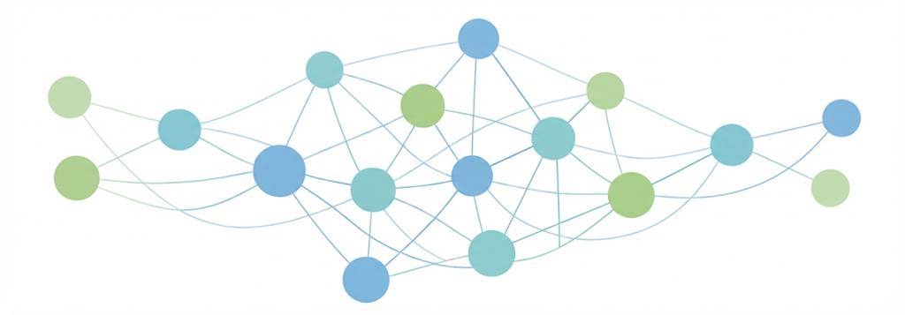
BIP Machine Learning for Data Science
Mobility Week: 19/01/2026 – 23/01/2026

Slide 2
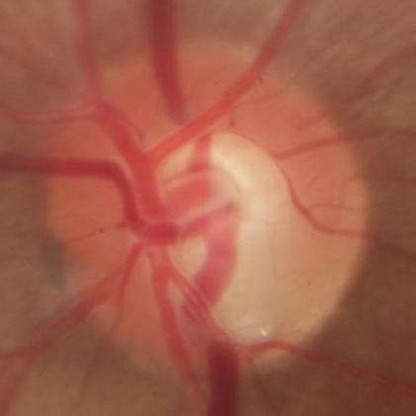
What is glaucoma?
Glaucoma is one of the leading causes of blindness worldwide.
It is known as the silent blindness because in many cases it presents almost no symptoms until the disease is already quite advanced.
It is very difficult to diagnose in its early stages due to the absence of clear biomarkers.
Neuroretinal rim
Cup
Disk

Slide 3
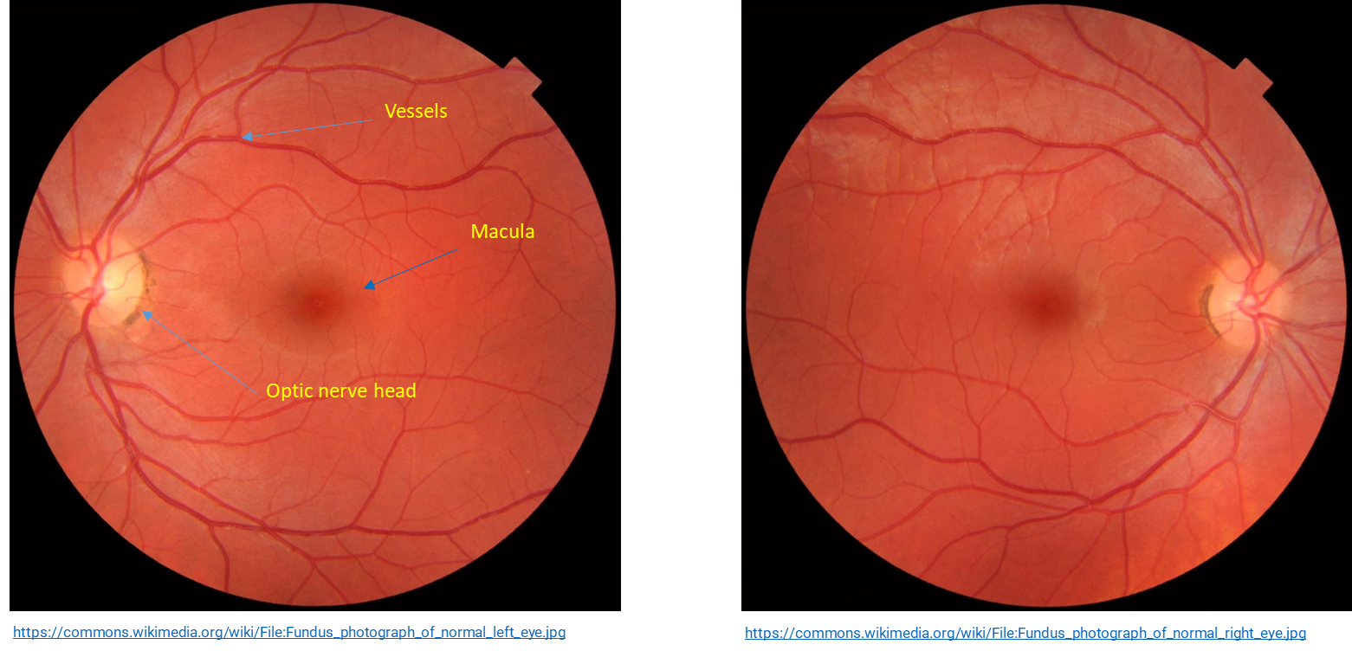
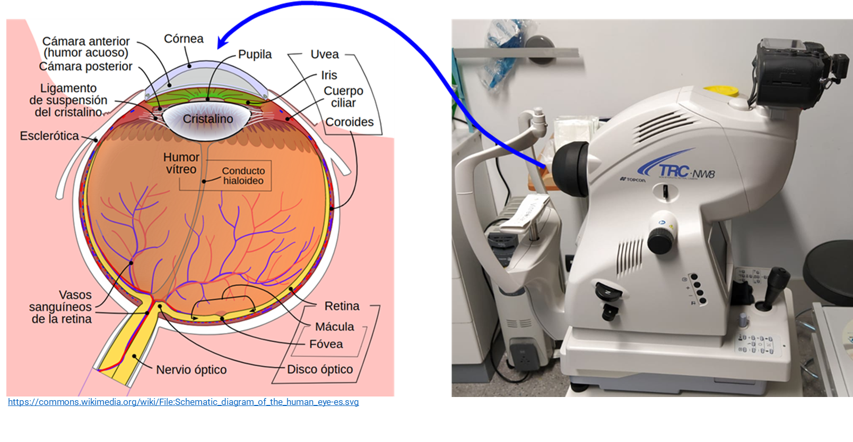
Fundus images

Slide 4
Task
We have to train a machine learning model capable of classifying retinal images to distinguish between healthy and glaucomatous eyes.
Also, we have to use some explainability mechanism on this model. Some of the main challenges of this task include:
High variability between patients' eyes.
Low-quality or noisy retinal images.
Visual similarities between healthy and glaucomatous optic nerves, especially when glaucoma is in an early stage.

Slide 5

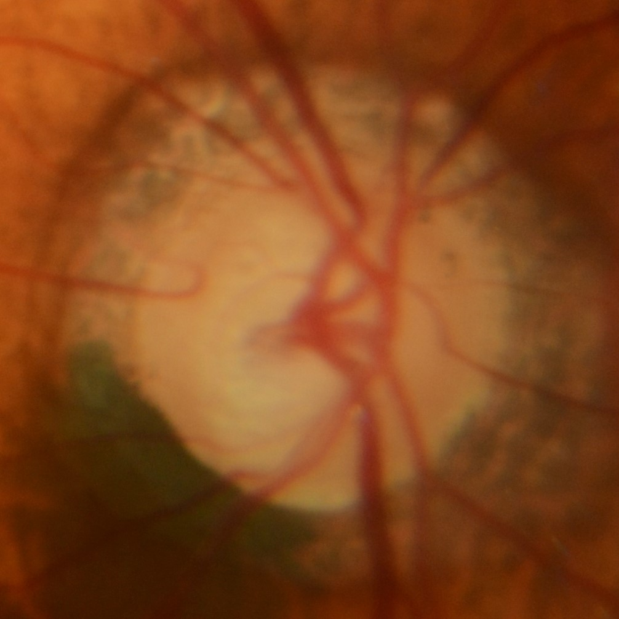
Diagnosis of glaucoma using convolutional neural networks
Convolutional Neural Networks (CNNs) offer a powerful solution for image classification tasks. By training a CNN on a large set of labeled retinal images, the network can automatically learn to extract relevant features and differentiate between healthy and glaucomatous cases.
https://commons.wikimedia.org/wiki/File:Typical_cnn.png

Slide 6
Diagnosis of glaucoma using convolutional neural networks
Key advantages of using CNNs:
Automatic feature extraction.
High potential accuracy.
Fast image classification once trained.
Challenges and Limitations
Risk of overfitting, especially with small datasets.
Limited interpretability of the models (“black box” problem).
Need for extensive clinical validation to ensure real-world reliability.

Slide 7
Dataset
RIM‑ONE DL (Retinal IMage database for Optic Nerve Evaluation – Deep Learning edition) is a unified version (2020) of the original RIM‑ONE datasets (v1, v2, v3), optimized for deep-learning tasks in glaucoma detection.
485 retinal fundus photos
313 labeled normal
172 labeled glaucoma-positive
Note: We will use the random partition of the dataset

Slide 8
Competition
Your model must be implemented in Pytorch and will be evaluated on a secret test set using the following metrics:
Balanced Accuracy: Overall correctness for imbalanced datasets
Accuracy: Overall correctness
Precision: Of positive predictions (glaucoma), how many are correct?
Recall (Sensitivity): Of actual glaucoma cases, how many did we catch?
Specificity: Of actual normal cases, how many did we correctly identify?
F1 Score: Harmonic mean of precision and recall
AUC-ROC: Area under the ROC curve
Ranking: Final ranking will be based primarily on Balanced Accuracy, with F1-Score as tiebreaker.
Note: the models will be submitted following the instructions detailed in the virtual campus.

Slide 9
Building Interpretable Surrogate Models for CNNs
Glaucoma Detection via Morphological Feature Approximation

Slide 10
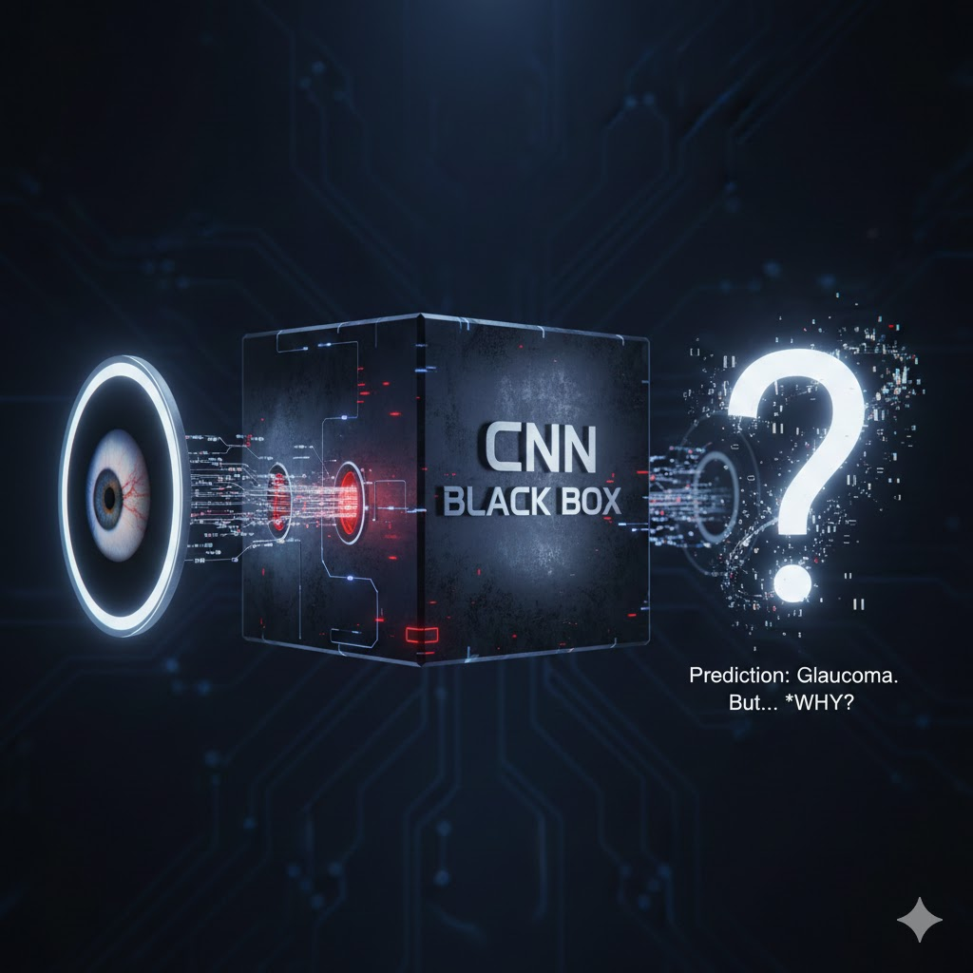
The "Black Box" Problem
Why Interpretability Matters in Healthcare
The Problem: CNNs are highly accurate but act as "black boxes," making it hard to explain why a glaucoma prediction was made.
The Trust Gap: Clinical settings require transparency and the ability to identify key features for patient safety.
The Solution: Surrogate models act as proxies to mimic the CNN's behavior using interpretable rules.

Slide 11
Task Overview & Data Structure
Predicting Probability, Not Class
Objective: Build a model that predicts the CNN's glaucoma_probability based on hand-crafted features.
Input Data: Morphological features like Cup-to-disc ratio (CDR), rim area, and blood vessel characteristics.
Target Data: The continuous probability scores (0.0 to 1.0) generated by your trained CNN.
Note: This is a Regression Task, not a classification task.

Slide 12
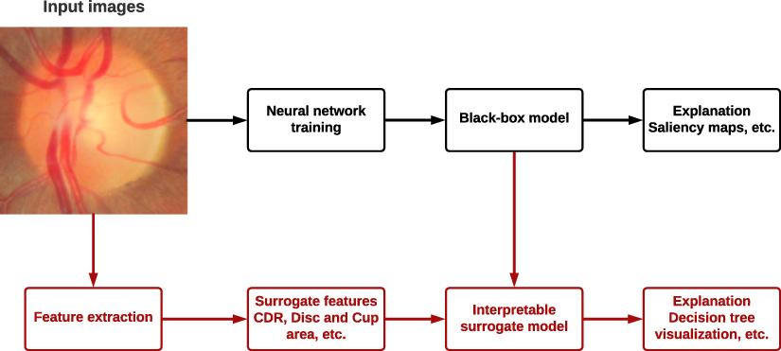
Explainability of AI decisions: Surrogate models

Slide 13
Why Use Surrogate Models?
Benefits of Interpretability
Feature Importance: Discover which clinical measurements matter most to the CNN.
Model Validation: Ensure the CNN isn't relying on "shortcuts" or biases.
Efficiency: Faster and requires fewer resources than deep learning models.
Clinical Acceptance: Meets regulatory requirements for transparency.

Slide 14
Suggested Modeling Approaches
Interpretable ML Techniques
Decision Trees: Best for rule-based visualization; captures non-linear relationships.
Linear Regression: Maximum interpretability via feature weights; assumes linear patterns.
Random Forests: Higher performance and built-in importance, though slightly less visual.
Polynomial Regression: Captures more complexity than linear models while remaining manageable.

Slide 15
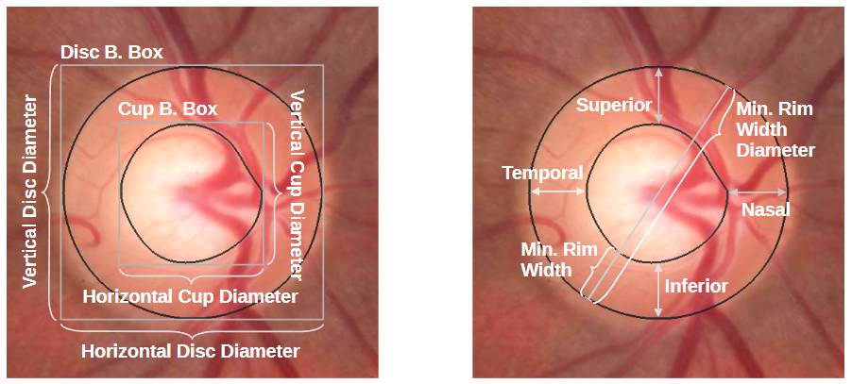
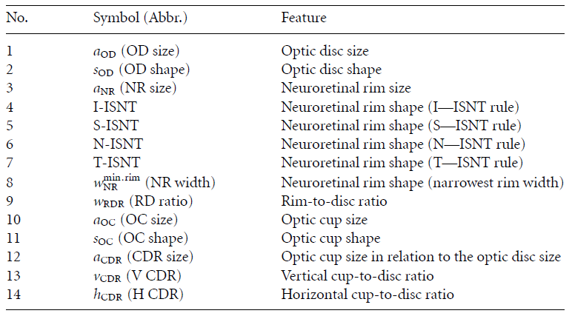
Morphological features dataset
14 features related with the optic cup and disc

Slide 16
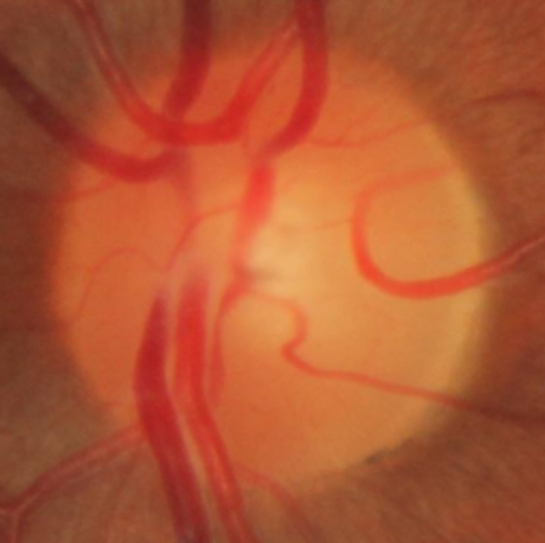
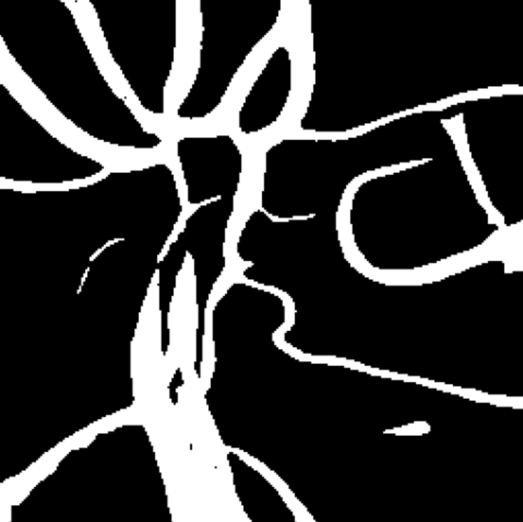
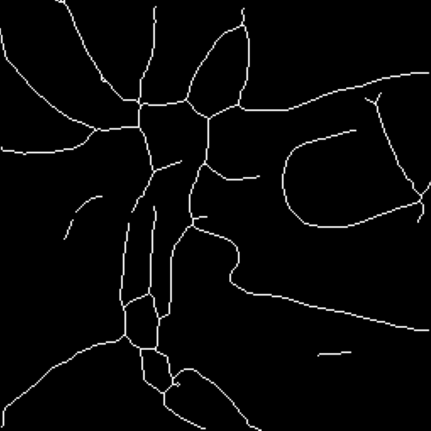
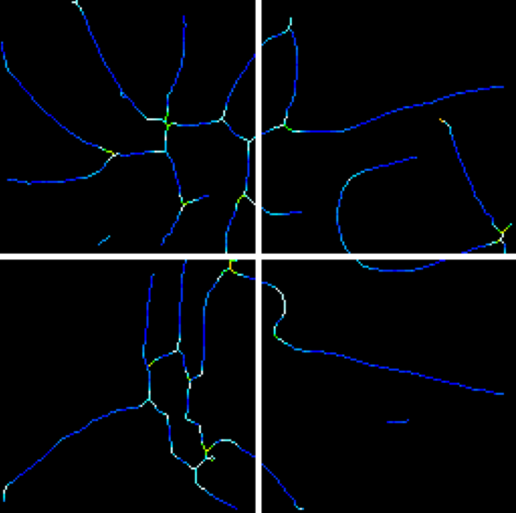
Morphological features dataset
11 features related with the vessels curvature
Mean and maximum vessel curvature (radians)
Global: in the whole image
In each sector: Top Left (TL), Top Right (TR), Bottom Left (BL), Bottom Right (BR)
Horizontal distance between the image center and the centroid of the pixels of the vascular tree (pixels)

Slide 17
Measuring Success (Evaluation)
Regression Metrics
MAE (Mean Absolute Error): Direct interpretation of the average error in probability (e.g., 0.05 = 5% off).
RMSE (Root Mean Squared Error): Penalizes larger errors more heavily; same units as predictions.
R² Score: Tells you how much of the CNN’s variance your surrogate model actually explains.

Slide 18
Shedding more light into the Black Box
GradCAM Visualization for CNN Interpretability

Slide 19
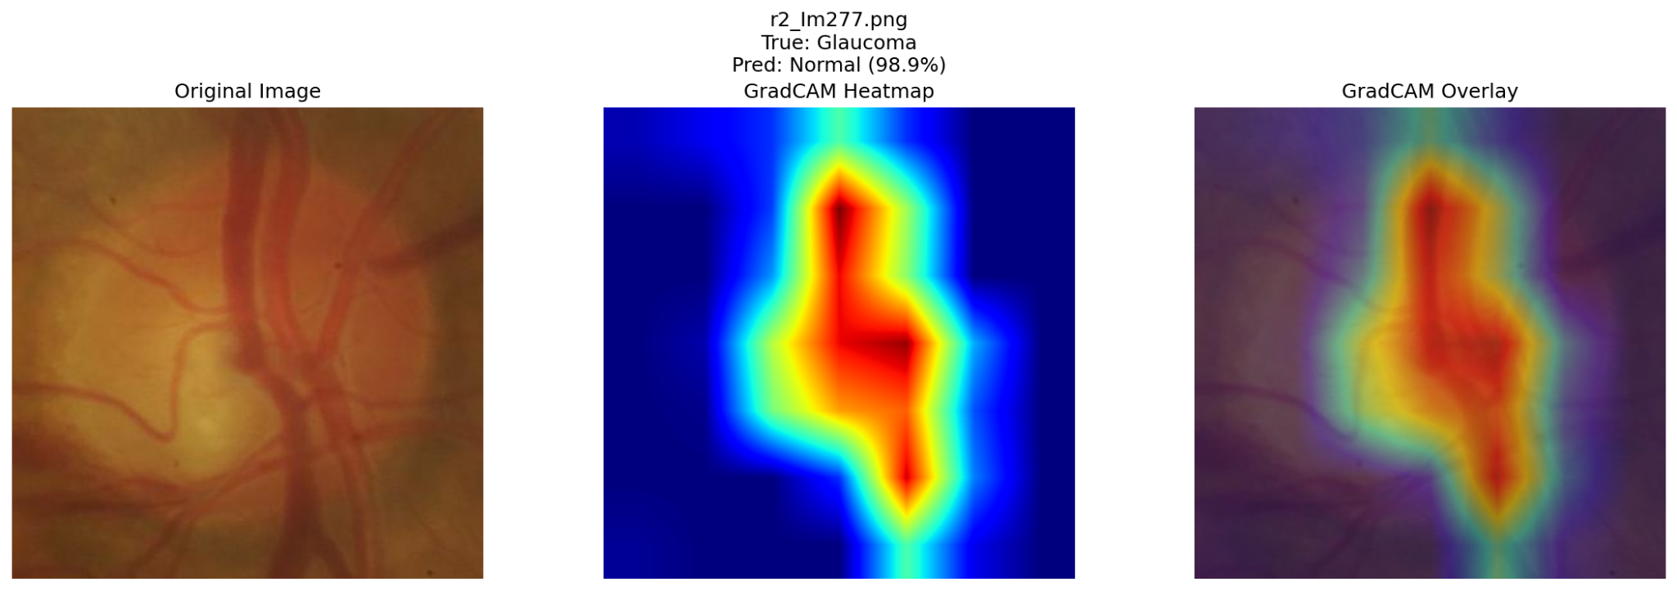
The task
You can use your best model in the competition to create visualizations in the RIMONE-DL test, where for each test set image, you can show:
Original retinal image
GradCAM heatmap
Overlay of heatmap on original image

Slide 20
Why is GradCAM Important?
Model Validation
Verify the model looks at clinically relevant regions
Check if it's using shortcuts or artifacts
Ensure it focuses on the optic disc for glaucoma
Trust and Transparency
Show doctors what the AI is "seeing"
Build confidence in predictions
Meet explainability requirements

Slide 21
Why is GradCAM Important?
Clinical Insights
Compare model attention with expert knowledge
Discover if CNN found novel patterns
Validate medical relevance of predictions
Error Analysis
Understand why the model makes mistakes
Identify biases in the model
Find problematic images or patterns

Slide 22
Final scheme for our project
CNN for Glaucoma Classification
Surrogate models
GradCam
Explainability mechanisms

Slide 23
Any questions?

